Slide 1

Lecture 1:
Introduction to Java
MIT-AITI Kenya 2005

Slide 2
Lecture Outline
What a computer program is
How to write a computer program
The disadvantages and advantages of using Java
How a program that you write in Java is changed into a form that your computer can understand
Sample Java code and comments

Slide 3
Computer Program vs. Food Recipe
Food Recipe
A chef writes a set of
instructions called a recipe
The recipe requires specific
ingredients
The cook follows the
instructions step-by-step
The food will vary depending on
the amount of ingredients and
the cook
Computer Program
A programmer writes a set of
instructions called a program
The program requires specific
inputs
The computer follows the
instructions step-by-step
The output will vary depending
on the values of the inputs and
the computer

Slide 4
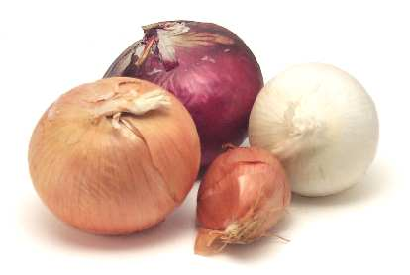
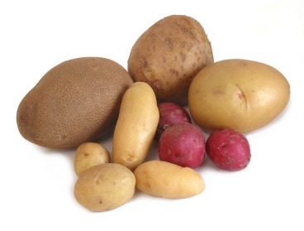

Recipe and Program Examples
Student’s
Name
Student’s
Grade
Recipe
Program
“Bilha got an A
on the exam!”

Slide 5
What is a computer program?
For a computer to be able to perform specific tasks (i.e. print what grade a student got on an exam), it must be given instructions to do the task
The set of instructions that tells the computer to perform specific tasks is known as a computer program

Slide 6
Writing Computer Programs
We write computer programs (i.e. a set of instructions) in programming languages such as C, Pascal, and Java
We use these programming languages because the are easily understood by humans
But then how does the computer understand the instructions that we write?
Notes:
Consider

Slide 7
Compiling Computer Programs
Computers do not understand programs written in programming languages such as Pascal and Java
Programs must first be compiled or converted into machine code that the computer can run
A program that translates a programming language into machine code is called a compiler

Slide 8


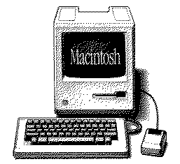
Compiling Computer Programs
Because different platforms, or hardware architectures along with the operating systems (Windows, Macs, Unix), require different machine code, you must compile most programs separately for each platform.
program
compiler
compiler
compiler
Unix
Win
Mac

Slide 9
Compiling Java Programs
The Java compiler produces bytecode not machine code
Bytecode is converted into machine code using a Java Interpreter
You can run bytecode on any computer that has a Java Interpreter installed
Win
Interpreter
Java Program
Java bytecode
Mac
compiler
Interpreter
Interpreter
Unix

Slide 10
Running Programs
Most programs follow a simple format:
An input is something you put into your program that your program can use during its execution.
Input
Execution
Output
When you execute your program, the computer evaluates the instructions in your program step-by-step.
An output is something your program produces after execution.

Slide 11
Running Programs
Inputs
  Can come from many sources, such as users, files, and other programs
  Can take on many forms, such as text, graphics, and sound
Outputs
  Can also take on many forms, such as numbers, text, graphics, sounds, or commands to other programs

Slide 12
Running Programs
(string of text)
(number)
Student’s
Name
Student’s
Grade
inputs
Program
execution
“Bilha got an A
on the exam!”
output
(string of text)

Slide 13
Running Programs Pop Quiz
You want to write a program
that adds two numbers
What are the inputs to your program?
  the two numbers
What does your program do?
  adds the two numbers
What is the output of your program?
  the sum of the two numbers

Slide 14

Compiling and Running Programs in Java
Java computer
program
Compiler
bytecode
Interpreter
You only need to compile your Java program once!
machine code

Slide 15
Advantages of Using Java
Once a Java program is compiled you can run the bytecode on any machine with a Java interpreter. Because you do not have to recompile the program for each machine, Java is platform independent.
Java is safe. In other words, the Java language and compiler prevent certain common programming bugs and dangerous operations
Java standardizes many useful operations such as managing network connections and providing graphical user interfaces

Slide 16
Disadvantages of Using Java
Running bytecode through an interpreter is not as fast as running machine code, which is specific to each platform.
Using platform specific features (e.g. Windows taskbar) is difficult in Java because Java is platform-independent.
In order to run a Java program on multiple machines, you must install a Java Interpreter on each machine

Slide 17
Running and Compiling Programs Pop Quiz
How many times do you need to compile a Java program in order to run it on two different platforms? Why?
  Once! Java is platform independent.
When you compile a Java program, what is the name of the resulting output?
  Bytecode
Why might running a program in Java be slower than running a program in a language that requires a separate compiler?
  Bytecode has to be run through the interpreter. This process
  takes more time that running machine code that is specific to
  each platform.

Slide 18
Example Java Code
This is part of the code that you will be writing in Lab 0:
/* The HelloWorld class prints “Hello, World!” to the screen */
public class HelloWorld {
public static void main(String[] args) {
// Prints “Hello, World!”
System.out.println("Hello, World!");
}
}
Notes:
Add comments on the code (make sure to same font)

Slide 19
Comments
Comments are used to describe what your code does as an aid for you or others reading your code. The Java compiler ignores them.
Comments are made using //, which comments to the end of the line, or /* */, which comments everything inside of it (including multiple lines)
Two example comments:
  /* The HelloWorld class prints “Hello, World!” to the screen */
  // Prints “Hello, World!”

Slide 20
Comments on Commenting
You may collaborate on software projects with people around the world who you’ll never meet.
Should be able to figure out how code works by reading comments alone.
Anything that is not self-evident needs a comment.
50% of your code might be comments.
Coding is easy; commenting is not.

Slide 21
This lecture covered…
What a computer program is
How to write a computer program
How a program written in Java is changed into a form that a computer can understand
The disadvantages and advantages of using Java
An example of Java code and comments

